Slide 1
CHAPTER 4

Slide 2
 | System Implementation &Configuration Management
4.1 | Packages and interfaces: Distinguishing between classes/interfaces, Exposing class and package interfaces
4.2 | Mapping model to code , Mapping Object Model to Database Schema
4.3 | Component and deployment diagrams: Describing dependencies
4.4 | Managing and controlling Changes
4.5 | Managing and controlling version

Slide 3
Version Control
Version control combines procedures and tools to manage different versions of configuration objects that are created during the software process.
A version control system implements four major capabilities:
(1) a project database that stores all relevant configuration objects

Slide 4
Version Control
(2) a version management capability that stores all versions of a configuration object.
(3) a make facility that enables construct a specific version of the software.
(4) version control and change control systems often implement an issues tracking (also called bug tracking) capability

Slide 5
Version Control
A number of version control systems establish a change set—a collection of all changes that are required to create a specific version of the software.
named change sets can be identified for an application or system.
construct a version of the software by specifying the change sets (by name)

Slide 6
Version Control
Modeling approach for building new versions contains:
Template for building version
Construction rules
Verification rules

Slide 7
Change Control
Too much change control and we create problems.
large software project, uncontrolled change rapidly leads to chaos.
For large projects change control combines human procedures and automated tools to provide a mechanism for the control of change.

Slide 8
Change Control
engineering change order (ECO).
elements of change management:
Access Control
Access control governs which software engineers have the authority to access and modify a particular configuration object.

Slide 9
Change Control
2. Synchronization Control.
Synchronization control helps to ensure that parallel changes, performed by two different people, don’t overwrite one another.
Informal Change Control
Developer makes changes in project

Slide 10
Change Control
project level change control
developer must gain approval from the project manager to makes changes.
formal change control
is instituted when the software product is released to customers

Slide 11
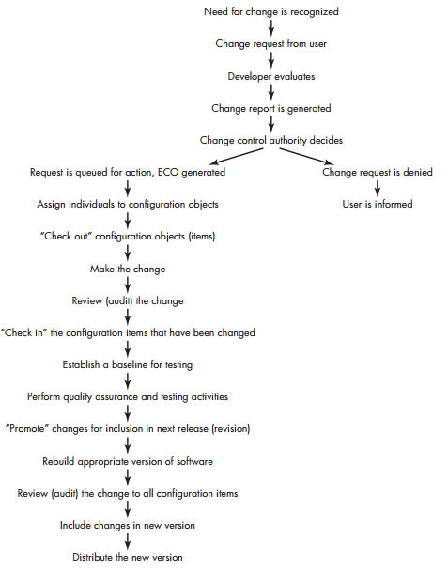

Slide 12
Component diagram
Component diagram shows components, provided and required interfaces, ports, and relationships between them.
It does not describe the functionality of the system but it describes the components used to make those functionalities.
Component diagrams can also be described as a static implementation view of a system.

Slide 13
Component diagram
The component diagram's main purpose is to show the structural relationships between the components of a system.

Slide 14
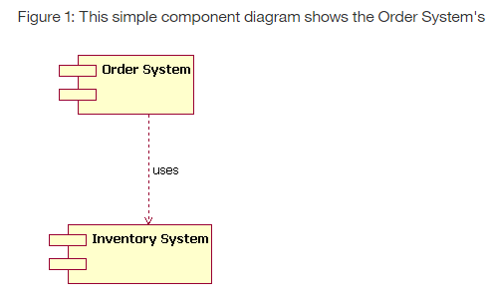
Component diagram

Slide 15
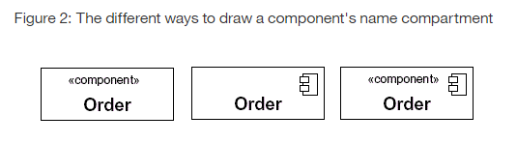
Component diagram

Slide 16
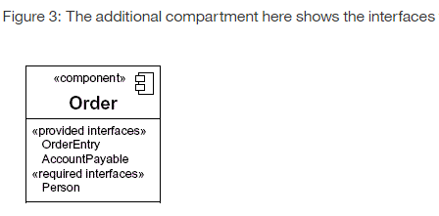

Slide 17
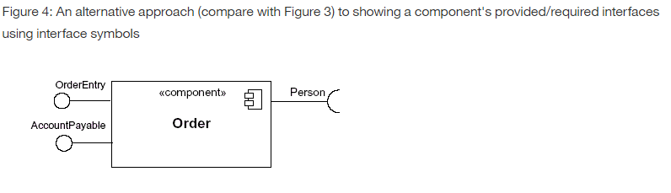

Slide 18
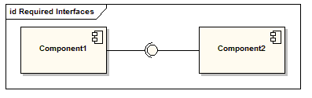
Component diagram
The assembly connector bridges component’s required interface (Component1) with the provided interface of another component (Component2); this allows one component to provide the services that another component requires.

Slide 19
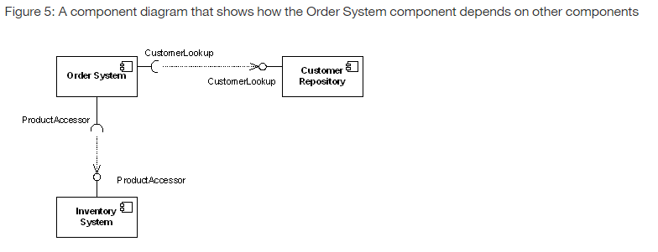

Slide 20
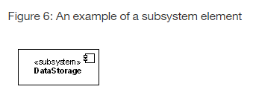

Slide 21
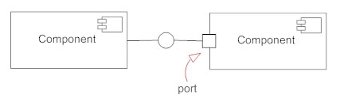
Component diagram
Port
Ports are represented using a square along the edge of the system or a component. A port is often used to help expose required and provided interfaces of a component.

Slide 22
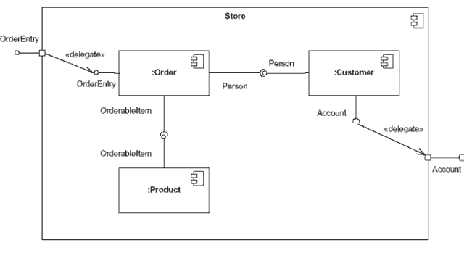
Component diagram
This component's inner structure is composed of other components

Slide 23
Component diagram
Online Shopping UML Component Diagram Example
Online shopping UML component diagram example with three related subsystems - WebStore, Warehouses, and Accounting.

Slide 24
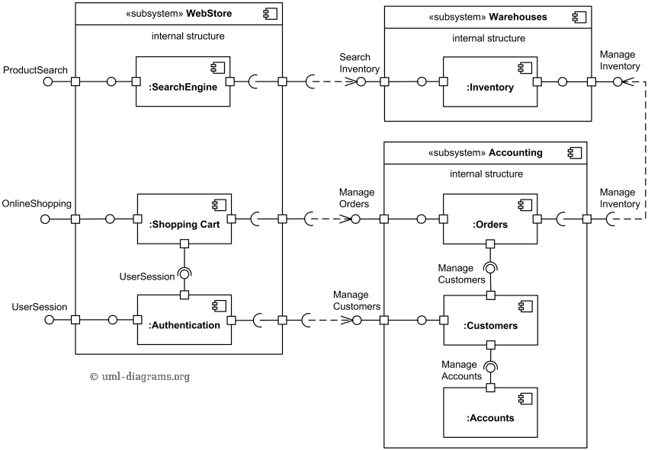

Slide 25
Deployment Diagram
A deployment diagram is used to show the allocation of artifacts to nodes in the physical design of a system.
Deployment Diagrams are made up of a graph of nodes connected by communication associations to show the physical configuration of the software and hardware.

Slide 26
Deployment Diagram
Essential elements of deployment diagram
Artifacts
Artifact is a physical item that implements a portion of software design.
It can be an source file , document or another item related to code.
Notation of artifact consists of class rectangle name of artifact and label <<artifact>>

Slide 27
Deployment Diagram
2. Nodes
A node is computational resource containing memory and processing on which artifacts are deployed for execution.
Notation of node three dimensional cube.
Nodes denote hardware, not software entities.

Slide 28
Deployment Diagram
3. Connections
Nodes communicate via messages and signals , through communication path indicated by solid line.
Communication paths are usually considered to be bidirectional, for unidirectional, an arrow may be added to show the direction
Each communication path may include an optional keyword label, such as «http» or «TCP/IP», that provides information about the connection.
multiplicity for each of the nodes connected via a communication path.

Slide 29
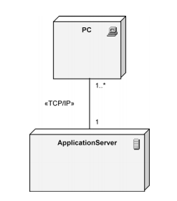

Slide 30
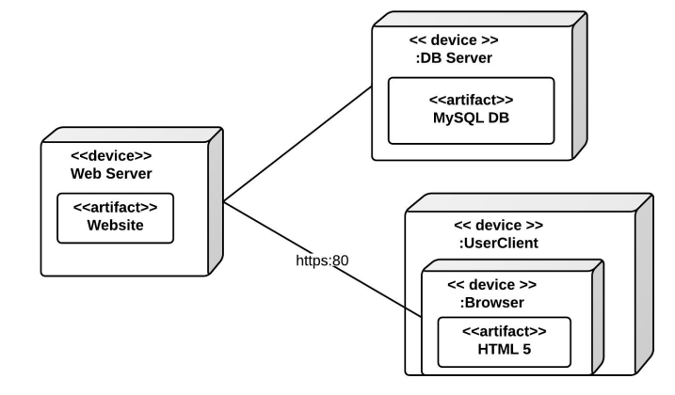

Slide 31
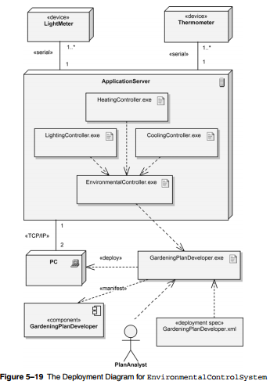

Slide 32
Mapping Models to Code
A transformation aims at improving one aspect of the model (e.g., its modularity) while preserving all of its other properties (e.g., its functionality).
Transformation Activities:
Optimization
This activity addresses the performance requirements of the system model.

Slide 33
Mapping Models to Code
Examples
Reducing multiplicities
adding redundant associations for efficiency,
adding derived attributes to improve the access time to objects.
2. Realizing associations
map associations to source code constructs,
Example
references and collections of references.

Slide 34
Mapping Models to Code
3. Mapping contracts to exceptions
describe the behavior of operations when contracts are broken.
This includes raising exceptions when violations are detected.
4. Mapping class models to a storage schema
selected a persistent storage strategy, such as a database management system, a set of flat files, or a combination of both.
map the class model to a storage schema, such as a relational database schema.

Slide 35
Mapping Models to Code
Four types of transformations:
Model transformations
A model transformation is applied to an object model and results in another object model.
purpose of object model transformation is to bringing it into closer compliance with all requirements.
A transformation may add, remove, or rename classes, operations, associations, or attributes.

Slide 36
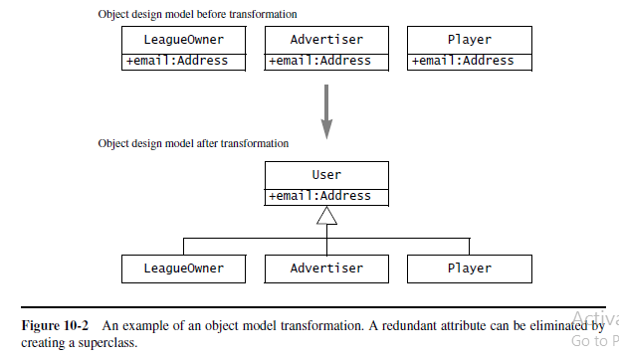

Slide 37
Mapping Models to Code
2. Refactoring
A refactoring is a transformation of the source code that improves its readability or modifiability without changing the behavior of the system.
Refactoring aims at improving the design of a working system.
the refactoring is done in small incremental steps that are interleaved with tests.

Slide 38
Mapping Models to Code
the object model transformation of Figure shown corresponds to a sequence of three refactorings.

Slide 39
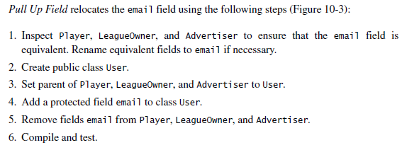
Mapping Models to Code
The first one, Pull Up Field, moves the email field from the subclasses to the superclass User.

Slide 40
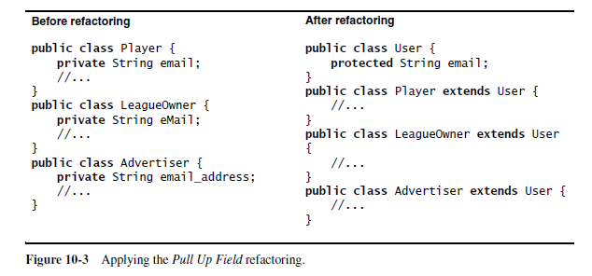
Mapping Models to Code

Slide 41
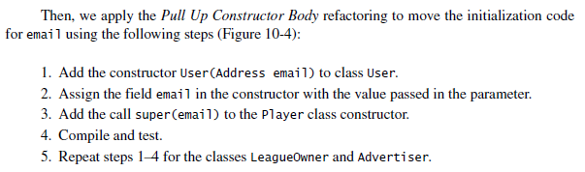
Mapping Models to Code
The second one, Pull Up Constructor Body, moves the initialization code from the subclasses to the superclass.

Slide 42
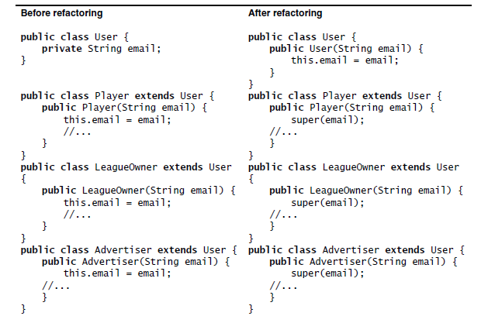

Slide 43


Mapping Models to Code
The third and final one, Pull Up Method, moves the methods manipulating the email field from the subclasses to the superclass.

Slide 44
Mapping Models to Code
Applying these three refactorings effectively transforms the ARENA source code in the same way the object model transformation

Slide 45
Mapping Models to Code
3. Forward Engineering
Forward engineering is applied to a set of model elements and results in a set of corresponding source code statements, such as a class declaration, a Java expression, or a database schema.
Purpose of forward engineering is to maintain a strong correspondence between the object design model and the code, and to reduce implementation errors.

Slide 46
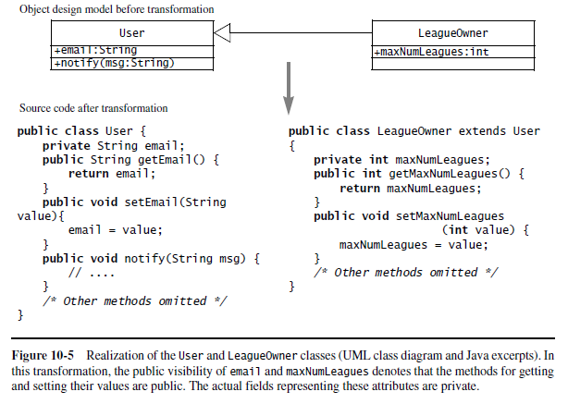

Slide 47
Mapping Models to Code
4. Reverse Engineering
Reverse engineering is applied to a set of source code elements and results in a set of model elements.
purpose - to recreate the model for an existing system, either because the model was lost or never created, or because it became out of sync with the source code.
Reverse engineering is essentially an inverse transformation of forward engineering.

Slide 48
Mapping Models to Code
Transformation Principles
A transformation aims at improving the design of the system with respect to some criterion.
To avoid introducing new errors, all transformations should follow certain principles:

Slide 49
Mapping Models to Code
Each transformation must address a single criteria.
2. Each transformation must be local. A transformation should change only a few methods or a few classes at once.
3. Each transformation must be applied in isolation to other changes.
4. Each transformation must be followed by a validation step.

Slide 50
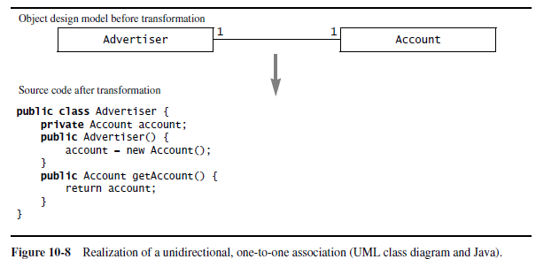
Mapping Models to Code
Mapping Associations to Collections
1. Unidirectional one-to-one associations.

Slide 51
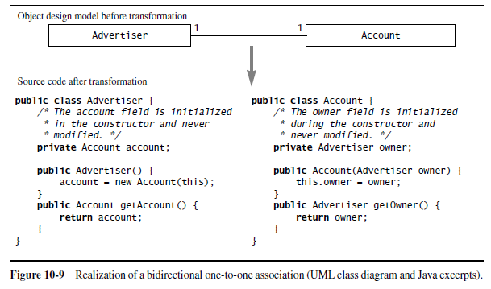
Mapping Models to Code
2. Bidirectional one-to-one associations.

Slide 52
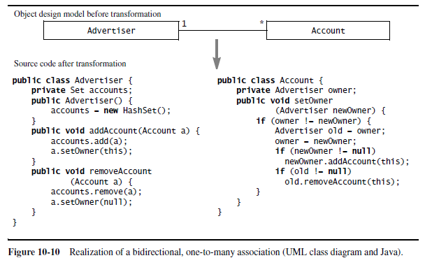
Mapping Models to Code
3. One-to-many associations.

Slide 53
Mapping Models to Code
4. Many-to-many associations.

Slide 54
Mapping Models to Code
Mapping Contracts to Exceptions
Checking preconditions.
Preconditions should be checked at the beginning of the method, before any processing is done.
There should be a test that checks if the precondition is true and raises an exception otherwise.
Each precondition corresponds to a different exception

Slide 55
Mapping Models to Code
2. Checking post conditions.
Post conditions should be checked at the end of the method, after all the work has been accomplished and the state changes are finalized.
Post condition corresponds to a Boolean expression in an if statement that raises an exception if the contract is violated.

Slide 56
Mapping Models to Code
3. Checking invariants.
When treating each operation contract individually, invariants are checked at the same time as post conditions.
4. Dealing with inheritance.
The checking code for preconditions and post conditions should be encapsulated into separate methods that can be called from subclasses.

Slide 57
Mapping Models to Code
5. Coding effort.
In many cases, the code required for checking preconditions and post conditions is longer and more complex than the code accomplishing the real work.
6. Increased opportunities for defects.
Checking code can also include errors, increasing testing effort.

Slide 58
Mapping Models to Code
7. Performances drawback.
Checking systematically all contracts can significantly slow down the code, sometimes by an order of magnitude. Although correctness is always a design goal, response time and throughput design goals would not be met.

Slide 59
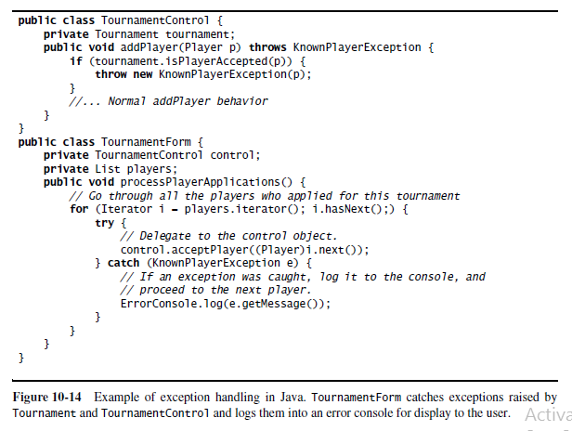

Slide 60
